Slide 1
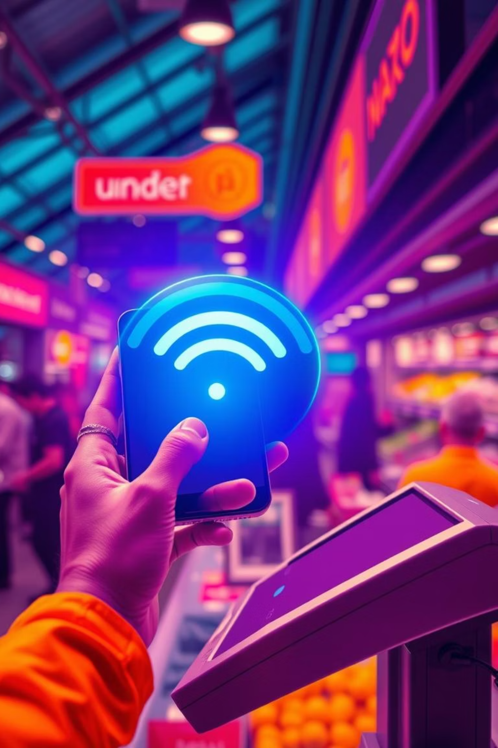
Revolutionizing Payments: Offline-First NFC
Explore an innovative payment system designed for instant, secure transactions, even without internet connectivity.
Kunwwer.ai

Slide 2
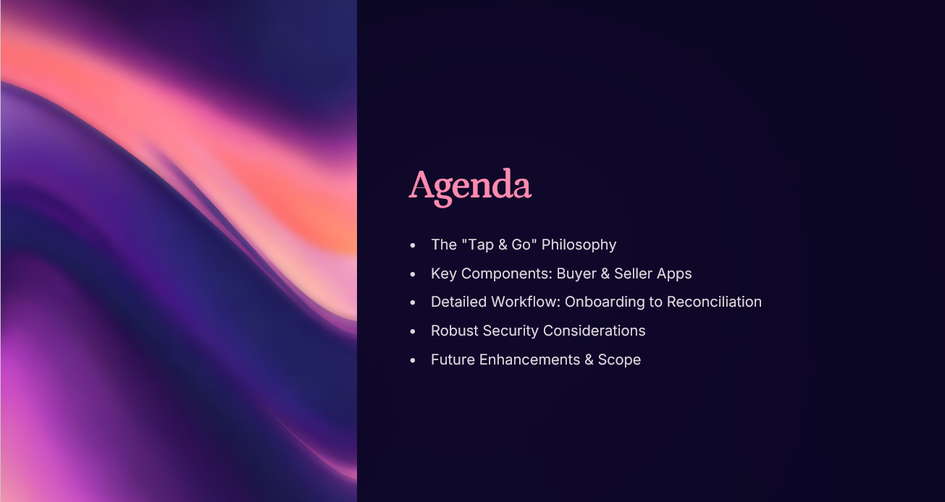
Kunwwer.ai

Slide 3
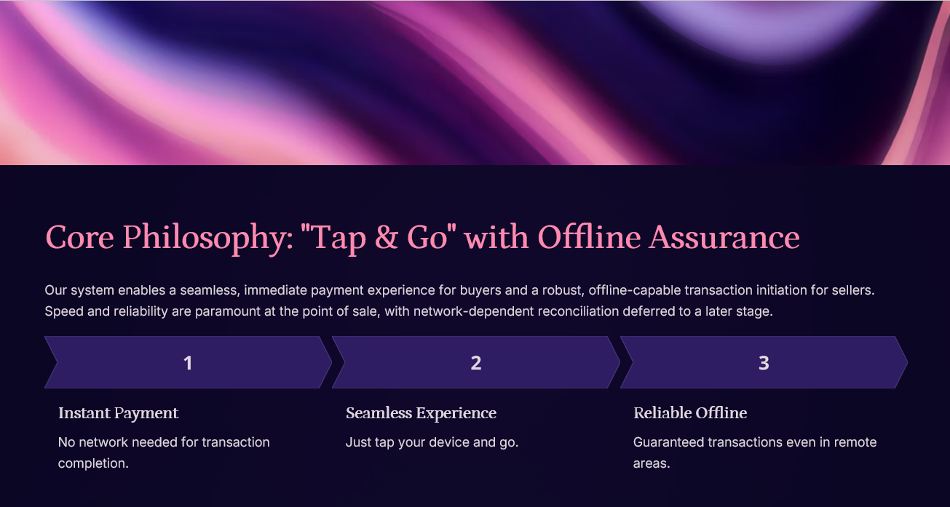
Kunwwer.ai

Slide 4
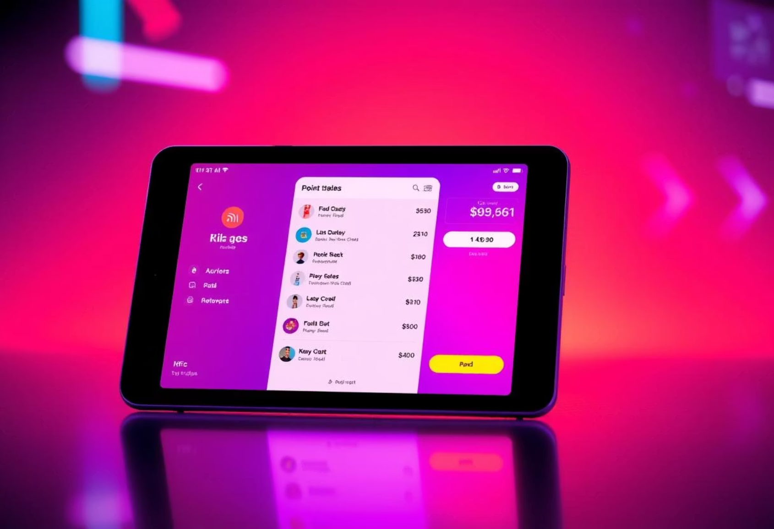
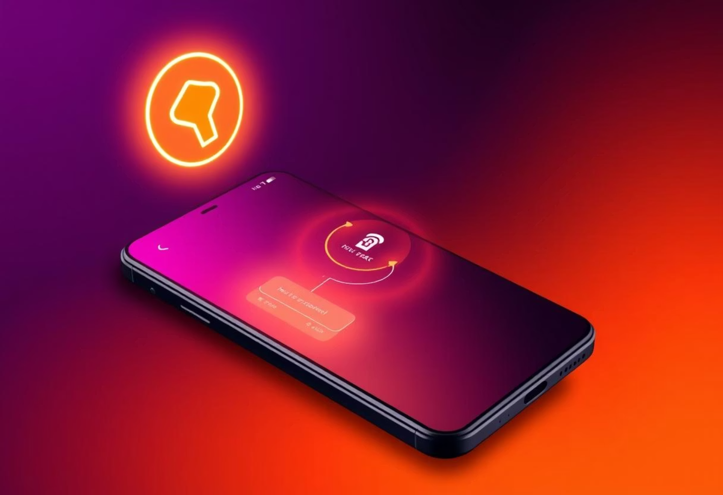
Key Components: Two Specialized Applications
Seller POS Application
Buyer NFC Payment System
Portable POS terminal & NFC reader.
Transforms phone into secure payment instrument.
Bill generation & transaction initiation.
Pre-authorized payment tokens.
Offline & synced transaction history.
Secure element integration.
Optional: basic inventory & KYC status.
Kunwwer.ai
Real-time limit display & biometric data storage.

Slide 5
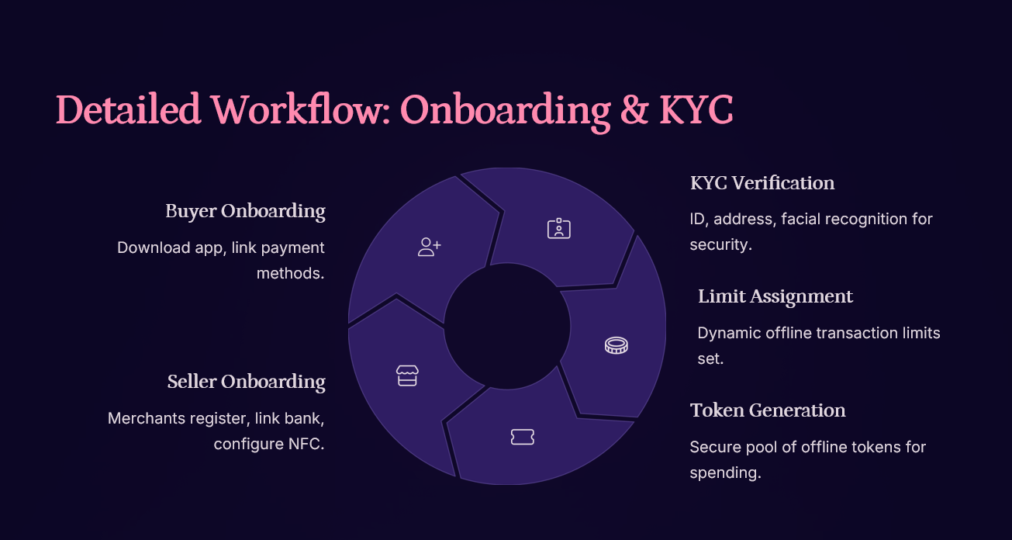
Kunwwer.ai

Slide 6
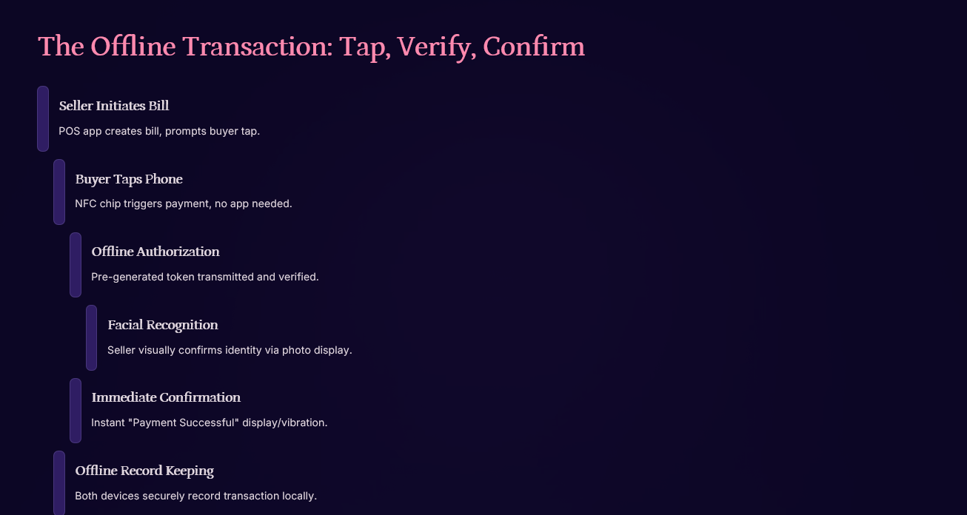
Kunwwer.ai

Slide 7
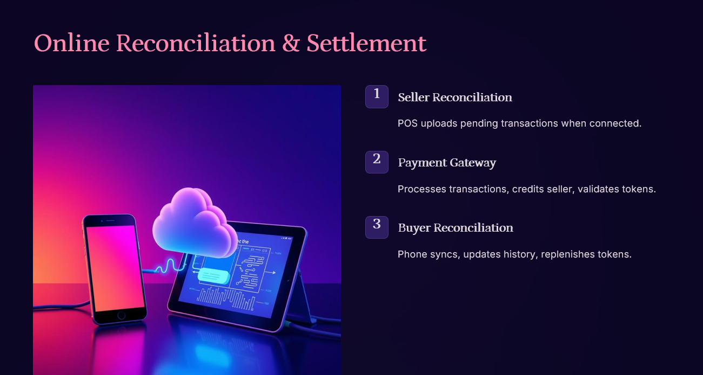
Kunwwer.ai

Slide 8
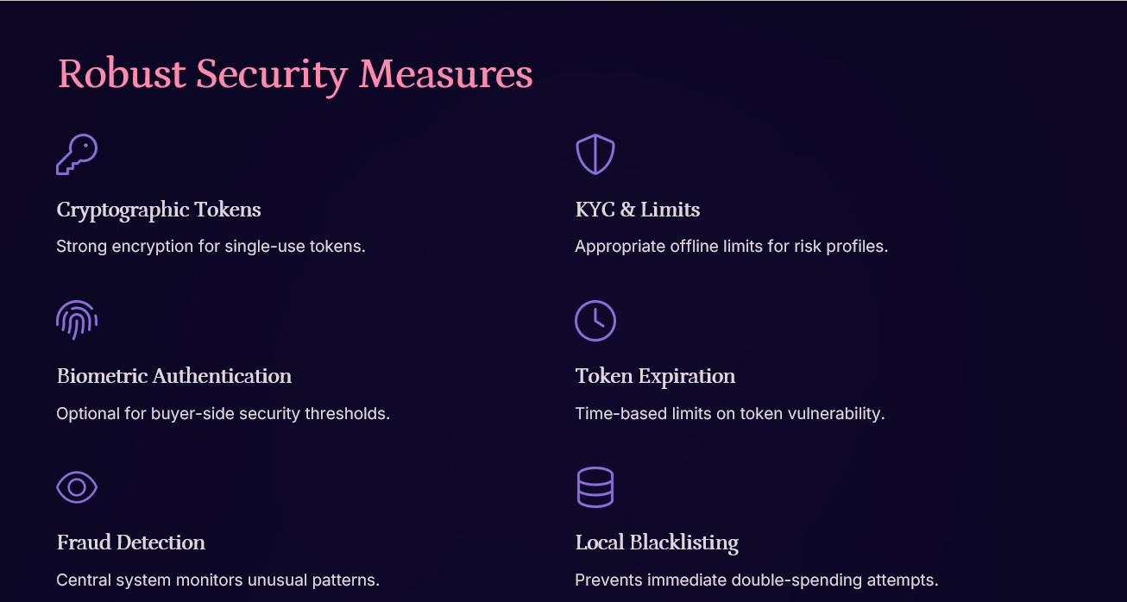
Kunwwer.ai

Slide 9
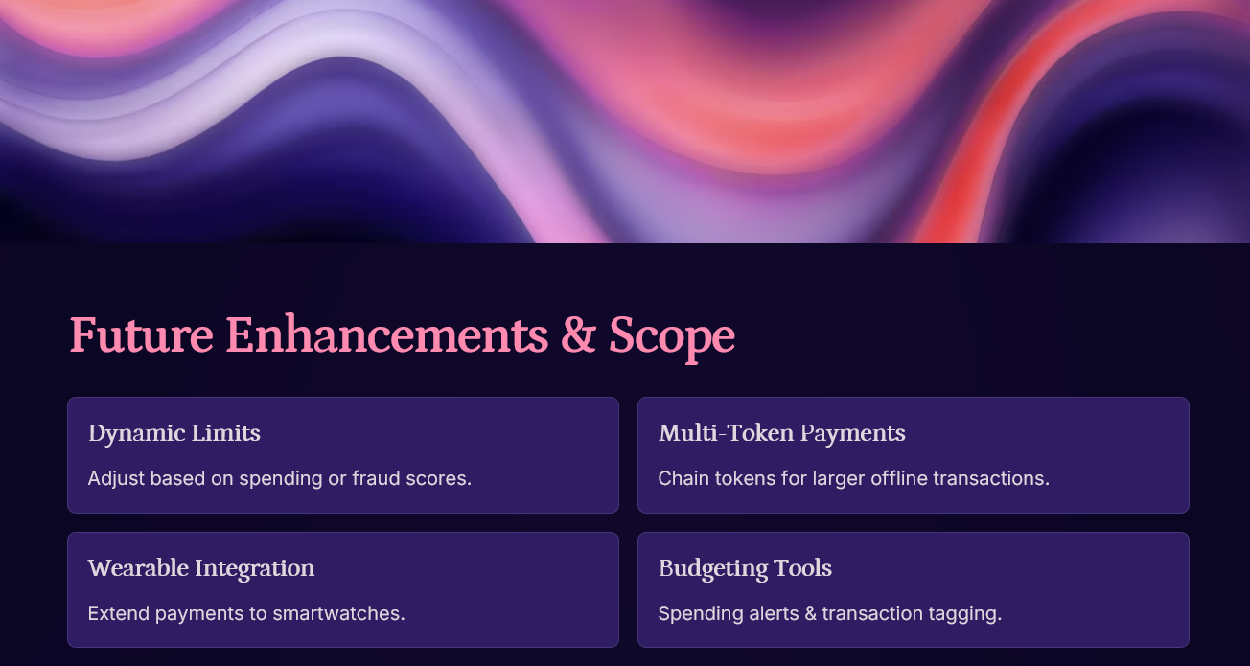
Kunwwer.ai

